Slide 1
ERP System

Slide 2
Basic Modules of ERP System
Inventory.
Human Resource.
Sales & Marketing.
Purchase.
Finance & Accounting.
Customer Relationship Management(CRM)

Slide 3
Enterprise Resource Planning System(ERP)
just by considering name we can simply define ERP as System or software that used to manage all the resources of the whole enterprise. Right from employee payments to a single screw coming into the enterprise, everything can be managed & tracked by using ERP Systems. ERP is a cross-functional software that supports all the business processes within the organization.

Slide 4
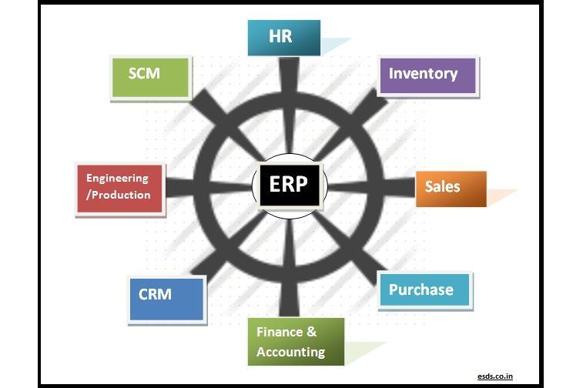

Slide 5
Inventory Module:
Inventory module can be used to track the stock of items. Items can be identified by unique serial numbers. Using that unique numbers inventory system can keep track of item and trace its current location in the organization.
e.g. you have purchased 100 hard disks, so using inventory system you can track how many hard disks are installed, where they are installed, how many hard disks are remaining etc.
Inventory module includes functionalities like inventory control, master units, stock utilization reporting etc.
There may be an integration of the inventory module with the purchase module of ERP.

Slide 6
Human Resource Module(HR)
Human Resource module helps to HR team for efficient management of human resources. HR modsule helps to manage employee information, track employee records like performance reviews, designations, job descriptions, skill matrix, time & attendance tracking. One of the important sub modules in the HR module is Payroll System which helps to manage salaries, payment reports etc. It can also include Travel Expenses & Reimbursement tracking. Employee Training tracking can also be managed by ERP.
And We can also implement A ticketing system which help to record employees job and performance

Slide 7
Sales Module
Typical sales process includes processes like Sales queries & inquiry analysis & handling, quotation drafting, accepting sales orders, drafting sales invoices with proper taxation, dispatch/Shipment of material or service, tracking pending sales order. All these sales transactions are managed by the sales module of ERP. CRM module can take the help of the Sales module for future opportunity creation & lead generation.

Slide 8
Purchase Module
As the name indicates, purchase modules take care of all the processes that are part of the procurement of items or raw materials that are required for the organization. Purchase module consists of functionalities like supplier/vendor listing, supplier & item linking, sending quotation request to vendors, receiving & recording quotations, analysis of quotations, preparing purchase orders, tracking the purchase items, preparing GRNs(Good Receipt Notes) & updating stocks & various reports. Purchase module is integrated with Inventory module & Engineering/production module for updating of stocks.

Slide 9
Finance & Accounting module
Whole inflow & outflow of money/capital is managed by the finance module. This module keeps track of all account-related transactions like expenditures, Balance sheet, account ledgers, budgeting, bank statements, payment receipts, tax management etc. Financial reporting is an easy task for this module of ERP. Any Financial data that is required for running the business is available on one click in Finance module.

Slide 10
Customer Relationship Management (CRM) module:
CRM department is helping to boost the sales performance through better customer service & establishing a healthy relationship with customers. All the stored details of the customer are available in the CRM module.
CRM module helps to manage & track detailed information of the customer like communication history, calls, meetings, details of purchases made by the customer, contract duration etc. CRM module can be integrated with the Sales module to enhance sales opportunities.

Slide 11
Inventory.

Slide 12
Supplier
Customer
Sales(sales , return)
Purchase(Purchase , return)
item
Categeroy1,2,3 (brand etc)
Tax (5%,12%,etc) will set automatically while selecting region And we can also add tax(eg : add Cess etc)
Rack
Price (purchase Rate , MOP , OP , MRP)
stock

Slide 13
Accounts

Slide 14
Cash Accounts
Bank Accounts
Income Accounts
Expense Accounts
Assets
Liabilities
Equity
Accounts Payable
Accounts Receivable
Cost of Goods Sold
Chart of Account

Slide 15
Account transactions
Commonly we can use ______ in every transaction in ERP system,we can simplify this using multiple sub entry
Entry's are
Cash payment / receipt
Card payment / receipt
Cyber payment / receipt
In every dr/cr transaction we can automatically generate cr/dr corresponding to the transaction

Slide 16
Reports

Slide 17
Every report contains graphical representation will help us to understand easily
Ledger (stock , account , personal)
Price list , stock list
Taxation report (upload format and with diff tax % eg.: 5% 12%)
Sales and purchase include return
Receivable and payable (supplier , customer)
Profit and Lose
Trial balance
Balance sheet

Slide 18
Store And Branch
May the company have Different Branches and every branch has several Stores
Mother warehouse supplies stock to each and every stores
So we must include stock transfer (stock in , stock out)
And branch transfer (in and out)
We can also include the vehicle registration like e-way bill while transferring goods

Slide 19
Taxation Report
We can provide different type of tax reports that related to (tax rule , rule format etc)
If we provide a report that helps to file tax return will help to manage tax issues easily
We can schedule and give a alert to end user when the tax file date is over or near

Slide 20
SALES

Slide 21
Create a sales order (SO)
Call the so to sales
Select the payment type(cash/card/credit/cyber or multi tender)
If stock is ‘0’ then create a purchase order Atomically (PO)
Negative stock or zero stock will never allowed to enter in sales(SL)
Update the Stocklist and Pricelist
Diff Discount And Diff Rate for Each Or Group of Customers
2 types of tax (include and exclude tax must consider)
Tax after discount and before discount

Slide 22
PURCHASE

Slide 23
Create a Purchase order(PO) is optional
We can call all the unprocessed PO to Purchase
The purchasing rate will be updated in pricelist as a rate of that product
Select the supplier and make the payment
Select the payment type(cash/card/credit/cyber or multi tender)
Update the Stock list and Pricelist

Slide 24
Human Resource Management

Slide 25
Human resource management is an essential factor of any successful business.
The various subsystems under HR module are:
Personnel management: (HR master data, Personnel administration, information systems, recruitment, travel management, benefits administration, salary administration)
Organizational management: (Organizational structure, staffing, schedules, job descriptions, planning scenarios, personnel cost planning)
Payroll Accounting: (Gross/net accounting, history function dialogue capability, multi currency capability, international solutions)
Time management: (Shift planning, work schedules, time recording, absence determination)
Personnel development: Career and succession planning, profile comparisons, qualifications assessments, additional training determination. Training and event management.)

Slide 26
PERSONNEL MANAGEMENT
Personnel management includes numerous software components, which allow you to deal with human resources tasks more quickly, accurately and efficiently. You can use these components not only as part of the company wide ERP solution but also as stand alone systems.

Slide 27
i. Personnel Administration
Information is no longer owned by specific departments, but is shared by multiple entities across an organization. This eliminates duplicate entries reduces the chance for error and improves data accuracy.
ii. Employee Master Data
Human resource module has a centralized database with integration to multiple components for processing employee information.
The system provides tools to save time and help you tailor the system to fit your needs.
The HR module contains features for storing any desired information about your employees.
Most systems have the facility to scan the original documents for optical Storage.
The HR Information system displays graphical information such as organization charts or employee data.
The system can produce charts and reports-both standard and customer defined.

Slide 28
iii. Recruitment management
This function helps in hiring the right people with the right skills.
Reducing the cost of recruiting and hiring new employees is a challenge for the HR professional, who is responsible for placing people in the right job, at the right time, and with the right skills and education.
These requirements are fulfilled only through effective automation of the entire recruitment process.
The recruitment component is designed to help meet every facet of this challenge like managing open positions/requisitions, applicant screening, selection and hiring, correspondence, reporting and cost analysis.

Slide 29
iv. Travel Management
This module helps you in processing the travel expenses effortlessly, in several currencies and formants.
HR Travel management allows you to process a business trip from start to finish-from the initial travel request right through to posting in financial accounting and controlling.
This includes any subsequent corrections and all retroactive accounting requirements.
Travel management automatically calculates the tax.
It automatically processes credit card transactions for a particular trip.
In addition, Travel management provides multiple report formats.
You can enter receipts in any currency and then print reports in your native currency.

Slide 30
Salary Administration
This function helps you in simplifying the process of rewarding your employees.
Administration of salaries is an ongoing process within your human resource department.
It is particularly important during the review processes, when your goal is to justify reward good performance.
The salary administration module assists you in the salary review process by taking into account standard salary changes within the company as well as individual competition exceptions
Benefits Administration Using the benefits administration component, we can define eligibility groups and rules based on a wide range of factors. We can determine the variables, rules and costs formulas for each benefits plan.

Slide 31
ORGANIZATIONAL MANAGEMENT
This module will assist you in maintaining an accurate picture of your organizations structure, no matter how fast it changes. In many cases, graphical environments make it easy to review any moves, additions, or changes in employee positions.
Data can predict next move

Slide 32
PAYROLL ACCOUNTING
The payroll accounting system can fulfil the payroll requirements and provide you with the flexibility to respond to your changing needs.
Payroll accounting should address payroll functions from a global point of view.
You should be able to centralize your payroll processing, or decentralize the data based on country or legal entities.
Most payroll accounting systems give you the options and capabilities to establish business rules without modifying the existing payroll.
Many systems have the features to remind you when transactions are due for processing.
With payroll accounting, you have the ability to tailor the system to your organization requirement.
With country specific versions of payroll accounting, you can fulfil language, currency and regulatory requirements.

Slide 33
TIME MANAGEMENT
It is a flexible tool designed to handle complicated evaluation rules to fulfil regulatory requirements and determine overtime and other time related data.
The time evaluation component stores your organizations business rules and automatically validates hours worked and wage types.

Slide 34
Shift Planning
Shift planning module helps you to plan your workforce requirements quickly and accurately.
You can plan your shifts according to your requirements taking into consideration all criteria, including absences due to leave or sickness, and employee requests for time off.
Shift planning keeps you informed at all times of any staff excess or deficit.
Another advantage of shift planning is that it enables you to temporarily assign an employee or employees to another organizational unit where they are needed, allowing for a temporary change of cost centre.

Slide 35
PERSONNEL DEVELOPMENT
Effective personnel development planning ensures that the goals of the organization and the goals of the employee are in harmony. The benefits of such planning include improvements in employee performance, employee potential, staff quality, working climate and employee morale. ie. Training and Event Management
A good HR system will have scheduled seminars, training courses and business events.
On completion of a training course, appraisal forms can be automatically issued.
Appraisals can be carried out for instructors, attendees, business events and training courses

Slide 36
PLANT MAINTAINENCE MODULE
The achievement of world class performance demands delivery of quality products expeditiously and economically.
Organizations simply cannot achieve excellence with unreliable equipment.
Machine breakdown and idle time for repair was once an accepted practice. Times have changed.
Today when a machine breaks down, it can shut down the production line and the customer's entire plant.
The Preventive Maintenance module provides an integrated solution for supporting the operational needs of an enterprise wide system.
The Plant maintenance module includes an entire family of product covering all aspects of plant/ equipment maintenance and becomes, integral to the achievement of process improvement.
The major subsystems of a maintenance module are :
Preventive Maintenance Control.
Equipment Tracking.
Component Tracking.
Plant Maintenance Calibration Tracking.
Plant Maintenance Warranty Claims Tracking

Slide 37
QUALITY MANAGEMENT MODULE
The quality management module supports the essential elements of a system.
It penetrates all processes within an organization.
The task priorities, according to the quality loop, shift from production (implementation phase) to production planning
and product development (planning phase), to procurement and sales and distribution, as well as through the entire usage phase.
It handles the traditional tasks of quality planning, quality inspection and quality control.
The quality management module’s internal functions do not directly interact with the data or processes of other modules.

Slide 38
QUALITY MANAGEMENT MODULE FUNCTIONS
The quality management module fulfils the following functions:
QUALITY PLANNING: Management of basic data for quality planning and inspection planning, material specifications, etc.
QUALITY INSPECTION : Trigger inspections, inspection processing with inspection plan selection and sample calculation etc.
QUALITY CONTROL: Dynamic sample determination on the basis of the quality level history, quality management information system for inspections and inspection results and quality notifications, etc.

Slide 39
MATERIAL MANAGEMENT MODULE
The material management module optimizes all purchasing processes with workflow-driven processing functions.
Enables automated supplier evaluation, lowers procurement and warehousing costs with accurate inventory and warehouse management and integrates invoice verification.
The main module of material management are as follows:
i. Pre- Purchasing Activity. ii. Purchasing. iii. Vendor Evaluation. iv. Inventory management. v. Invoice verification and material inspection

Slide 40
MANUFACTURING MODULE
A good manufacturing system should provide for multi mode manufacturing applications that encompass full integration of resource management.
These manufacturing applications should allow an easier exchange of information throughout the entire global enterprise, or at a single site within a company.
The manufacturing module should enable an enterprise to combine technology with business processes to create an integrated solution.
It must provide the information based upon which the entire operation should be run.
It should contain the necessary business rules to manage the entire supply chain process whether within a facility, between facilities or across the entire supply chain

Slide 41
Major subsystem of the manufacturing module
Materials and capacity planning
Shop floor control
Quality management
JIT/repetitive manufacturing
Cost management
Engineering change control
Engineering data management
Configuration management
Tooling
Serialization/lot control

Slide 42
About the system

Slide 43
The system will expire after one month demo
Currency and tax will automatically set while registering company (while selecting region)
Must mange currency management & Unit Converter(eg: purchase in kg and sales in PCS)
We can keep database details outside the code (locally or cloud)
We can provide an Automatic Backup tool and store the backup in cloud (North American servers etc)
We can develop a Encryption method and save every sophisticated data in encrypted format

Slide 44
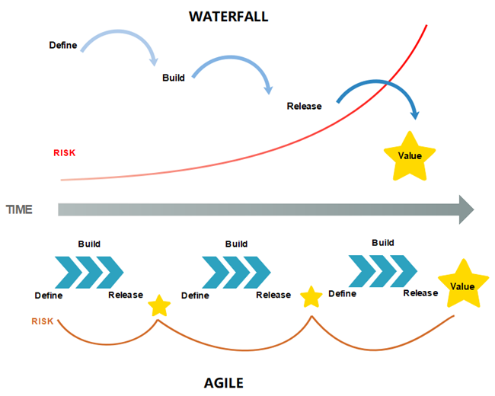
We can use AGILE method to develop this system which helps to reduce risk and will not take much time

Slide 45
About Development

Slide 46
We can divide Whole system into two
Inventory & CRM Module
AND
HR Module
Inventory & CRM Module
we want to complete this module with minimum of time ,the development of HR module and Testing of Inventory Module will be done simultaneously.

